Slide 1


Slide 2
HUMAN RESOURCE MANAGEMENT SEMESTER PROJECT :
GROUP MEMBERS:
AMARA KHAN
359
ARIBA ADNAN
401
AHMED ALI
340
ABDUL AHAD
349
SHAH AMEER
006
SHOAIB ABDULLAH 380
HUZAIFA NIAZ 364

Slide 3

THE COMPANY WHICH WE HAVE CHOSED FOR OUR PROJECT IS :

Slide 4

E-Sparks A TOP RANKED Magento Development Company, ACCORDING TO DESIGNRUSH
E-Sparks has been recognized among the Top Magento Development Companies in June, 2021 by DesignRush Marketplace. DesignRush is a reliable online guide to finding the best professional companies and agencies categorized according to vertical and area of expertise. After evaluating and analyzing E-Sparks’ performance with some of the most prominent brands in the World, the online platform gave E-Sparks a spot among the Top Magento Development Companies.

Slide 5
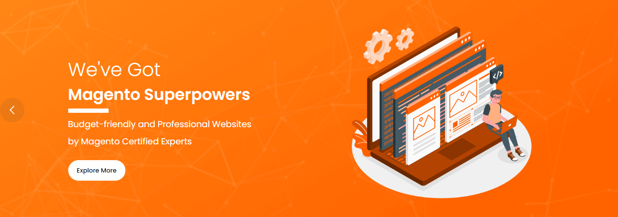

Slide 6


Slide 7
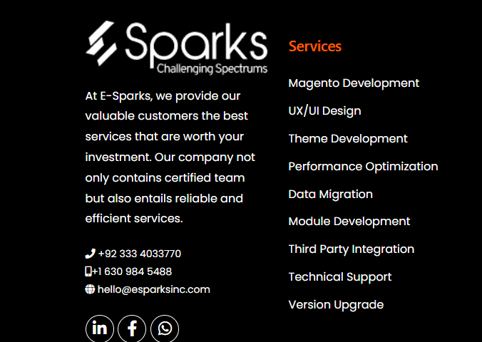

Slide 8
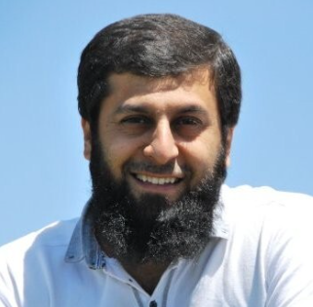
Message From The CEO
Esparks was created 5 years ago by Umair Zaman , According to him :
“E-Sparks, my brainchild, started with an intent of becoming the most trusted and sought-after E-commerce Development Company in the region with a vision of merging technology and innovation, and to provide e-commerce solutions under one umbrella from startups to small and large enterprises. However, despite having high-end technological expertise at the nucleus of it, I always ideated strong moral and ethical values to be at E-Sparks core.

Slide 9
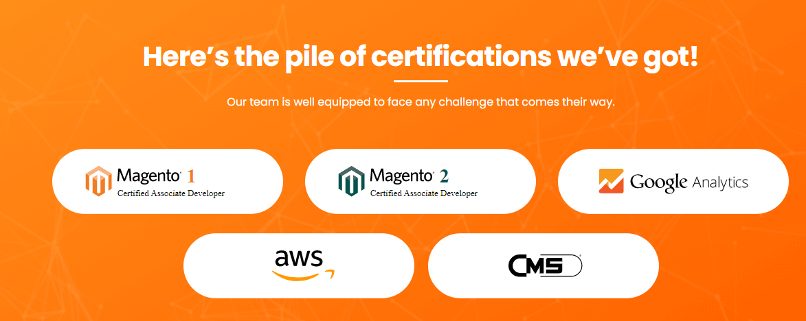

Slide 10

About Magento Superheroes
E-Sparks was started 5 years ago with a clear dream of becoming a trustworthy company among the e-commerce realm for Magento development services. Until now, E-Sparks has worked for many reputed clients and catered to their needs with the hard work, passion, and dedication of the Magento development team in providing quality results. In the upcoming years, E-Sparks aims to grow and expand its horizons while leaving a positive impact on society by promoting core values like integrity, transparency, inclusiveness, and fulfilling corporate social responsibility.

Slide 11
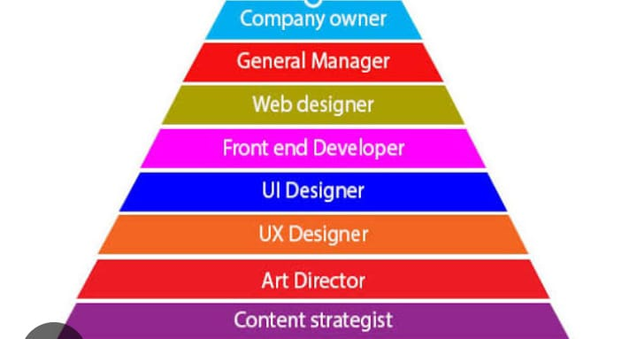
THE ORAGANIZATIONAL STRUCTURE WHICH IS FOLLOWED BY THIS WEBSITE DEVELOPMENT COMAPANY:

Slide 12
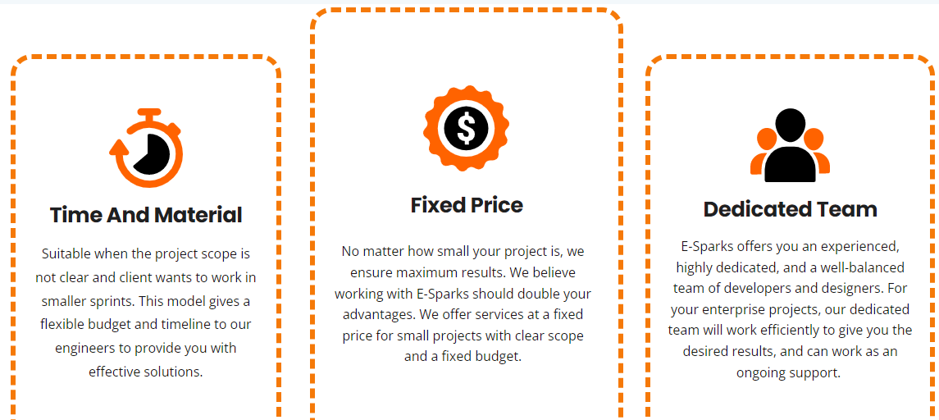

Slide 13
Team
They are a team of professionals with a creative approach to work.
At E-Sparks, there’s a team of highly skilled and talented people who are the true asset of our company. Together they build good relations with their clients by delivering the best results.
Website design and development solutions provided by ESPARKS Magento certified team are scalable, customer-centric, responsive, feature-packed, user friendly, and fully performing. They value our team by providing them a positive work environment so that they can work more diligently in achieving company goals.

Slide 14
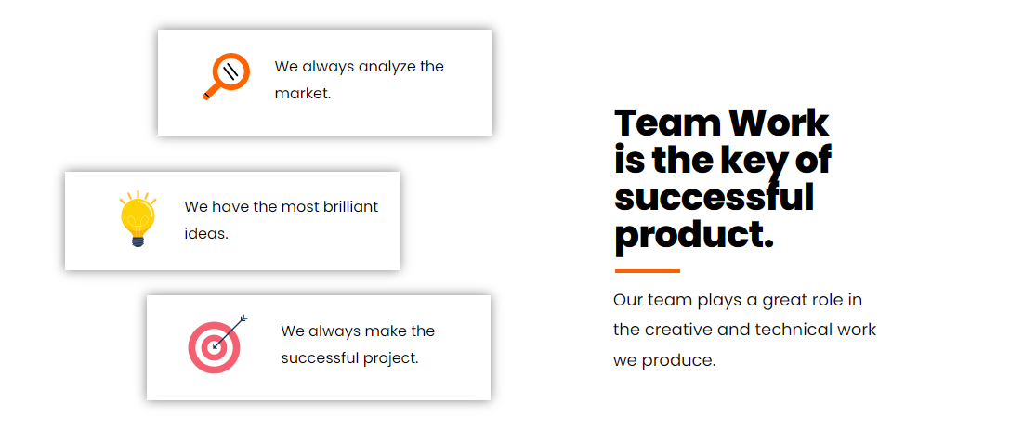
At Espark it considered that team work is the key to success

Slide 15
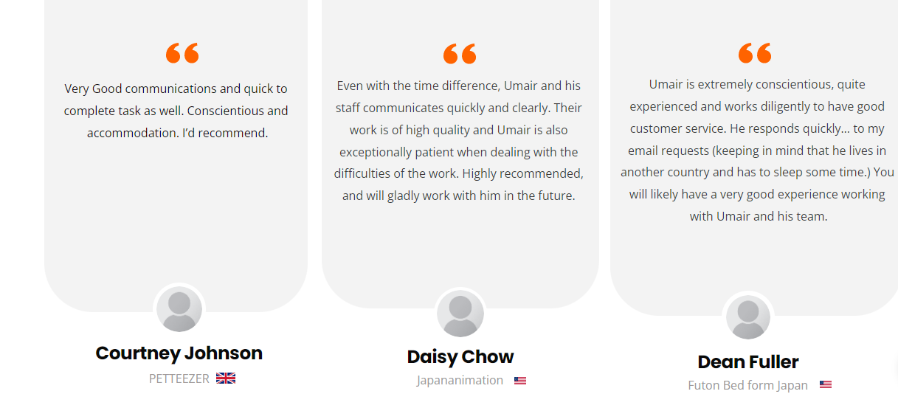
Here Is What Clients Say About Our Magento Superheroes:

Slide 16
Life at E-Sparks​
They guarantee you would want to work with them! They believe in working as a team, supporting each other to make the best use of our potential. They not only work to enhance their professional skills but they also strive to enhance each other’s personalities and build confidence.

Slide 17
Training & Development
Do you know how they built a powerful team? They believe in sharing knowledge and experiences. They motivate their employees to encourage each other every day with new, thoughtful, inspiring, and innovative ideas that can ultimately prove to be beneficial for them and the company.
They continuously make efforts to boost the productivity of their employees and for that, they frequently conduct training and development programs to make them learn and develop new skills to do their jobs well. They also work to support the personal development of their employees, as it improves their personalities and quality of life that acts as fuel to achieve professional goals.

Slide 18
Entertainment
Candidates will love working with them! At E-Sparks, they make sure to incorporate different recreational activities on a regular basis to share happy moments and create memories.
Such as birth day celebrations etc.

Slide 19
Mission
“Driving CLIENT Company’s TOWARDS Success!”
Their mission is to build long-term mutually beneficial relationships with their clients by using their knowledge, experience, creativity, and advanced technology in providing the best Magento website development services.
E-Sparks will be the spark that guides client’s path! At E-Sparks, client will get the best innovative and creative strategies which will help them to grow their business.

Slide 20
Vision
E-Sparks envision becoming the first choice of every business looking to nurture their Magento stores!”
They believe in delivering quality work to their clients and providing them with smart technological e-commerce solutions by merging technology and innovation for startups to small and large merchandise. They do not just focus on fulfilling duties but on building trust with the client through transparency and honesty.

Slide 21
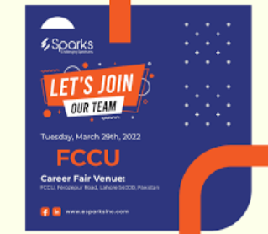
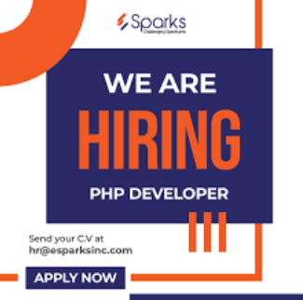
HIRING and RECRUITMENT:
At E-Sparks hiring is done through job interviews and they also reach out to different universities at job fairs to attract new and fresh candidates .

Slide 22
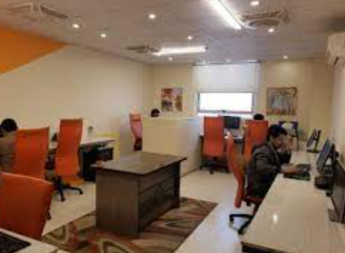
PERKS AND BENEFITS
E-SPARKS offer following PERKS and BENEFITS to their employees:
Professional Trainings
Work life Balance
Career Growth
Provident Fund
Annual Profit Sharing
Bonuses
Recreational Trips
Annual Dinner
Paid leaves
Birthday celebrations

Slide 23

Questions?
How Get In Touch
They’ll be happy to help answer any of your questions. Send us an email at hello@esparksinc.com and they will get back to you shortly.
ADDRESS:
AL-HAFIZ HEIGHTS ,11TH FLOOR,
GULBERG III,LAHORE.

Slide 24
Thank you so Much for your Attention

